Slide 1
Possibilities
Introduction to Statistics, Dr. Eugene Callahan

Slide 2
Introduction

Slide 3
Mathematicians Persecuted for Probability Theory?
My friend, an expert on the history of mathematics, could not think of a single case of this ever happening.
The author does not cite a single instance of this.
The Catholic Church had no interest in probability theory.
I.e., the claim is nonsense.

Slide 4
Birthday puzzle
You are at a party. How many people have to be there before it is more likely than not that two of them have the same birthday?
The answer turns out to be… 23!

Slide 5
A playoff series
We posit that two teams are evenly matched, but one happens to be up, 3-2, in a seven game series. What are the odds the team that is up will win?
Answer: team down has a 50% chance of winning game 6. If they win that, they have a 50% chance in game 7.
.5 * .5 = .25

Slide 6
Tree Diagrams

Slide 7
Tree Diagrams: A Playoff Series
6th game
7th game
Series 3-2
Cavs win
Cavs win
Warriors win
Warriors win

Slide 8
Tree Diagram: After dinner
Desert
Pie
Coffee
Tea
Ice cream
Cake
Tea
Coffee
Coffee
Tea

Slide 9
Multiplication Rules

Slide 10
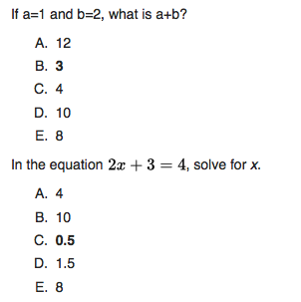
Multiplication Rule
If a choice consists of k steps, the first of which can be made in n₁ ways, the second in n₂ ways, and the kth in n_{k} ways, then there are:
n₁ * n₂ *… * n_{k} possibilities

Slide 11
Permutations

Slide 12
Permutations
If r objects are selected from a set of n objects, any particular arrangement of those r objects is called a permutation.
The total number of permutations of r objects selected from a set of n objects is n(n – 1)(n – 2)*…*(n – r + 1)
Why the payoff is high on the trifecta!

Slide 13
Permutations
When r = n, we are considering permutations of all of the objects.
In that case, the number of permutations is:
n(n – 1)(n – 2)*…* 3 * 2 * 1
And that leads us to...

Slide 14
Factorials

Slide 15
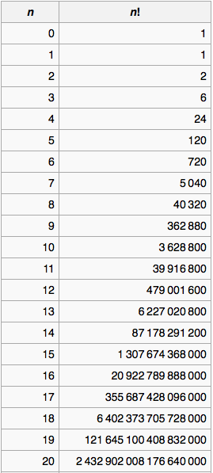
Factorials
N-factorial (n!) is defined as:
0! = 1
1! = 1
n > 1, n! = n * (n – 1)!

Slide 16
Factorials
The idea of factorials allows us to state the rule for choosing r objects from a set of n objects in a different way:
Choose 4 from 8:
8 * 7 * 6 * 5 = (8 * 7 * 6 * 5 * 4!) / 4! = 8! / 4!
Choose 5 from 16:
16 * 15 * 14 * 13 * 12 = (16 * 15 * 14 * 13 * 12 * 11!) / 11! = 16! / 11!
So, choosing r objects from n yields:
n! / (n – r)! permutations.
This helps because our calculators have factorial functions!

Slide 17
Indistinguishable Objects

Slide 18
Indistinguishable Objects
If we pick two items from the left, we will always get apple, apple: 4! / 4!
“Statistics”: 10 letters. If each was distinct: 10! combinations (3,628,800). But there 3 s’s, 3 t’s, and two i’s. So the actual number is: 10! / (3! * 3! * 2!) = 50,400
Let’s do 4 slots for 2 commercials.

Slide 19
Combinations

Slide 20
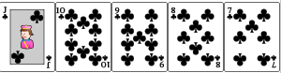
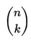
Combinations
Permutations: order matters.
Combinations: order doesn’t matter.
We need these formulas because it is tedious to work these out by hand for large numbers!
For a combination of r from n, we have: n! / ((n – r)! * r!)
We say, “52 choose 5”. Or “n choose k.” (Our book uses r instead of k.)

Slide 21
Binomial Coefficients

Slide 22
Pascal’s triangle
One way to choose zero objects!
One way to choose none of 1 object, and one way to choose one of 1 object.
One way to choose none of two objects, one way to choose both of two objects, and two ways to choose one but not the other.
Let’s think of light switches!

